Slide 1
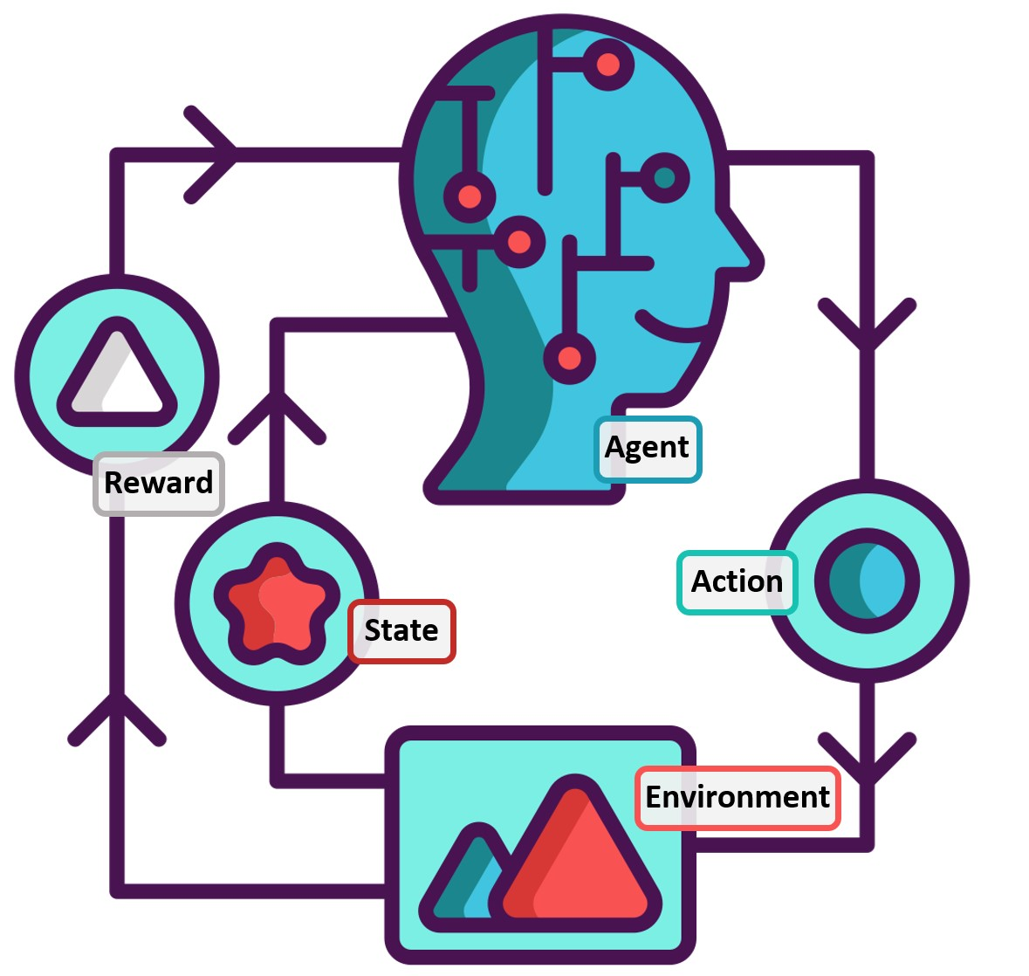


Safe Model-Based Reinforcement Learning with Uncertainty Estimates
Yibo Zhang, Shibei Zhu, Samuel Kaski
22.08.2023
Content is available under
CC BY 4.0 unless otherwise stated

Slide 2
Structure
Introduction
Safety in RL
Lyapunov function for safe-RL with Region of Attraction (ROA)
Related works
Lyapunov NN, GP-based safe region estimation.
Methods
Lyapunov Neural Network for dynamic model
Gausian Process
Experiment
Conclusion

Slide 3
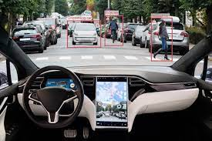
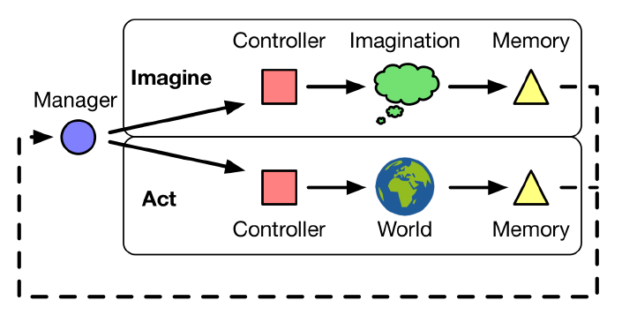
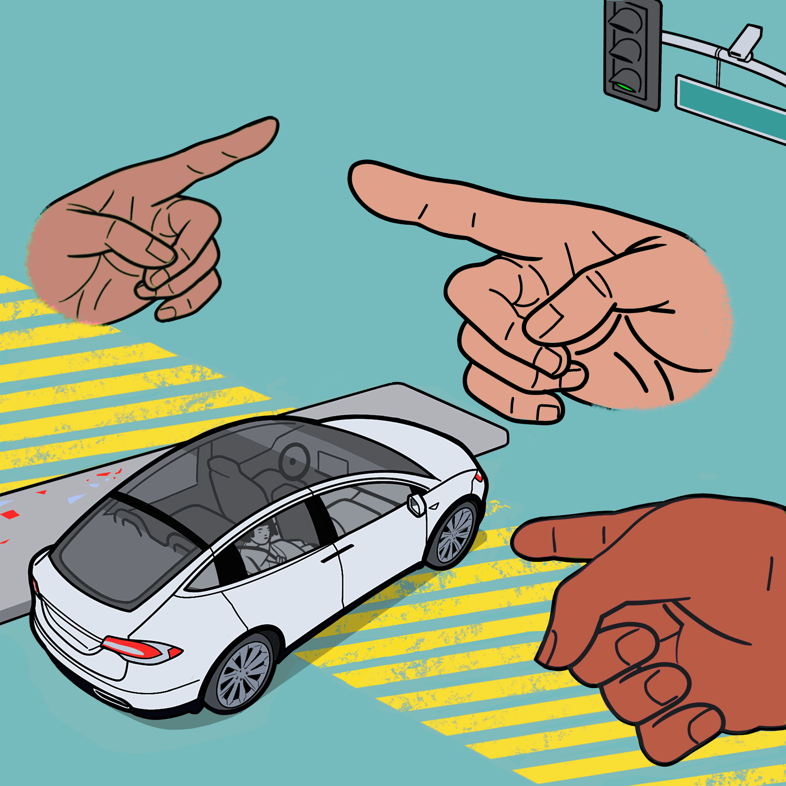
1.1 Safety in RL
An AI agent operates within predefined safety constraints
To minimize the risk of harmful or undesirable outcomes.
Critical when training & deploying in real-world environments
Notes:
Safety in Reinforcement Learning refers to the concept of ensuring that an AI agent or system operates within predefined safety constraints to prevent harmful or undesirable outcomes. In RL, safety becomes critical when training agents to interact with real-world environments, as undesirable actions could lead to catastrophic consequences.

Slide 4
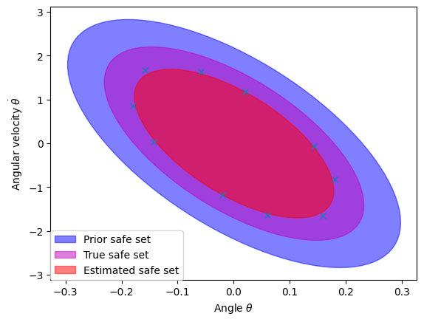
1.2 Region of Attraction
Region of Attraction (ROA): a safe subset of the state space in which a given controller renders an equilibrium point asymptotically stable
Any state within the ROA will asymptotically approach the stable equilibrium.
Notes:
One important property of nonlinear systems is the region of attraction (ROA), a safe subset of the state space in which a given controller renders an equilibrium point asymptotically stable. The ROA is typically estimated based on a model of the system. However, since models are only an approximation of the real world, the resulting estimated safe region can contain states outside the ROA of the real system. This is not acceptable in safety-critical applications. In this paper, we consider an approach that learns the ROA from experiments on a real system, without ever leaving the true ROA and, thus, without risking safety-critical failures.

Slide 5
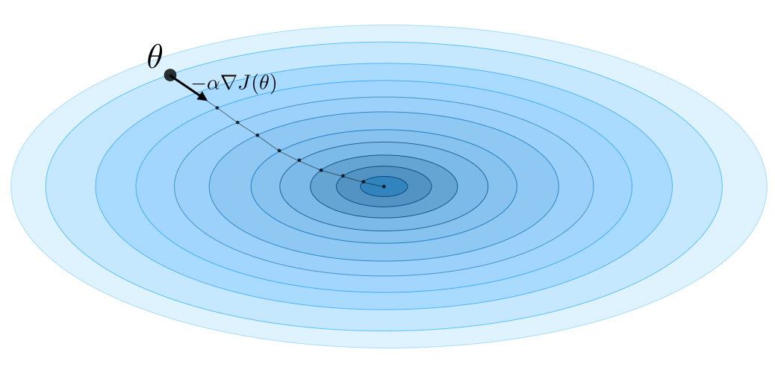
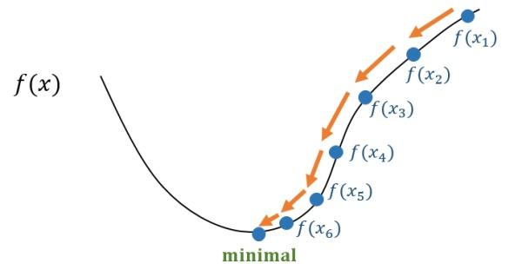
1.3 Lyapunov Function
Lyapunov Function is a scalar function that may be used to prove the stability of an equilibrium of an ordinary differential equation (ODE).
It measures the distance to the Equilibrium point in the state space.
A simple implementation is L2 norm.
Given a Lyapunov function, the problem of finding the ROA reduces to a line search for the maximum safe level set of the Lyapunov function.
Notes:
A Lyapunov function is a concept from dynamical systems theory and control theory. It is used to analyze the stability and convergence properties of dynamic systems, ensuring that they remain within safe bounds or equilibria. In the context of Reinforcement Learning (RL), Lyapunov functions can provide a formal framework to guarantee safety by verifying that the learned policies and behaviors of an agent do not lead to undesirable or unsafe states.

Slide 6
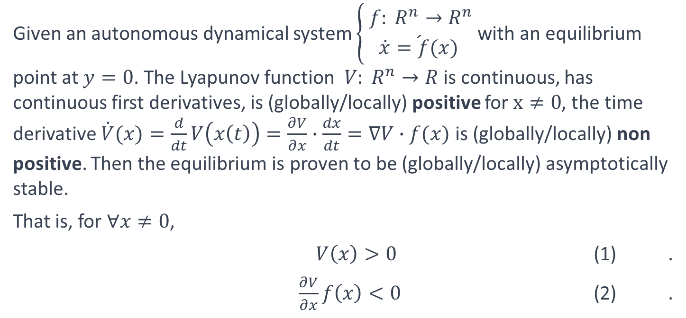
Lyapunov Function Definition
Given an autonomous dynamical system $\left\{\begin{aligned} f: R^{n}→R^{n} \\ \acute{\dot{x}=f(x)}\end{aligned}\right.$ with an equilibrium point at $y=0$. The Lyapunov function $V: R^{n}→R$is continuous, has continuous first derivatives, is (globally/locally) positive for $x≠0$, the time derivative $\dot{V}(x)=\frac{d}{dt}V\left(x\left(t\right)\right)=\frac{∂V}{∂x}∙\frac{dx}{dt}=∇V∙f(x)$ is (globally/locally) non positive. Then the equilibrium is proven to be (globally/locally) asymptotically stable.
That is, for $∀x≠0$,
$V\left(x\right)>0$ (1) .
$\frac{∂V}{∂x}f\left(x\right)<0$ (2) .

Slide 7
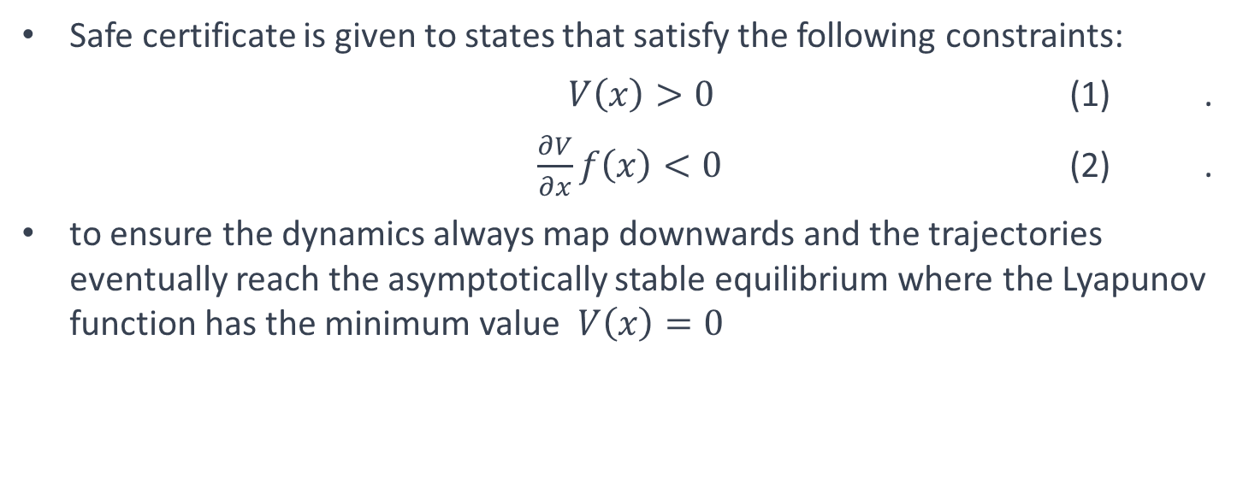
1.3 Lyapunov Function
Safe certificate is given to states that satisfy the following constraints:
$V\left(x\right)>0$ (1) .
$\frac{∂V}{∂x}f\left(x\right)<0$ (2) .
to ensure the dynamics always map downwards and the trajectories eventually reach the asymptotically stable equilibrium where the Lyapunov function has the minimum value $V\left(x\right)=0$
Notes:
Partial derivative of V with respect to x

Slide 8
Existing works
Classical methods to determine and quantify ROA
Use the quadratic Lyapunov function (like LQR) to simplify it to a polynomial systems problem, like Linear Matrix Inequalities [3], Lyapunov-like functions [4] and quadratic systems [6], and numerical method also be researched [5].

Slide 9
Challenges
Hard to establish model: The real world is usually a black-box model, hard to get true physical parameters for policy, true dynamic function and Lyapunov function.
Hard to find Lyapunov functions for a specific model that ensure positive V and non-positive time derivative 𝑉 ̇(𝑥)
Model contains errors: models are only an approximation of the real world, the resulting model-based estimated safe region can contain states outside the ROA of the real system.
Model contains uncertainty: Mainly for fixed uncertainty systems. Not applied to dynamic systems with noice.

Slide 10


2.1 Lyapunov Neural Network
[1] proposed a methods for learning control policies and neural network Lyapunov functions framework consists of a learner that attempts to find the control and Lyapunov functions, and a falsifier that finds counterexamples to quickly guide the learner towards solutions. The procedure terminates when no counterexample is found by the falsifier.
It solves Problem 2, but still relies on true models to generate LQR parameters.
# Loss function
Loss = -a*V + b*V_dot
+ c*(||x||-V)^2 + d*V(x0)^2
Controller
Dynamics
LQR
$${\dot{x}}_{i+1}$$
x_{i}
∇𝑉
$$\dot{V}$$
Loss
Lyapunov NN
V
train
Counter examples x_{i}
[1] Y. Chang, Neural Lyapunov Control, https://doi.org/10.48550/arXiv.2005.00611

Slide 11



# Loss function
Loss = -a*V + b*V_dot
+ c*(||x||-V)^2 + d*V(x0)^2
Controller
Dynamics
LQR
$${\dot{x}}_{i+1}$$
x_{i}
∇𝑉
$$\dot{V}$$
Loss
Lyapunov NN
V
train
Counter examples x_{i}
gym
My Lyapunov Function Module
train
x_{i}
Policy
DDPG
a_{i}
gym
X_{i+1}
x_{i}
# Loss function
Loss = -a*V + b*V_dot
+ c*(||x||-V)^2 + d*V(x0)^2
Dynamics
NN
Dynamics
NN
$${\dot{x}}_{i+1}$$
$${\dot{x}}_{i+1}$$
train
∇𝑉
Loss
$$\dot{V}$$
Loss
$$\dot{V}$$
Lyapunov NN
Lyapunov NN
Counter examples x_{i}
V
V
train
train

Slide 12
2.2 GP-based active learning
GP-based methods
[2] considers an approach that learns the ROA from experiments on a real system, without ever leaving the true ROA and, thus, without risking safety-critical failures.
Use Gaussian Process to approximate the model uncertainties, and use safe Bayesian optimization to actively learn real dynamics from experience executed within the estimated ROA, to reduce the uncertainty and expand ROA using high-probability constraints.
[2] F. Berkenkamp, Safe Learning of Regions of Attraction for Uncertain, Nonlinear Systems with Gaussian Processes, https://arxiv.org/abs/1603.04915

Slide 13
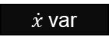
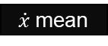
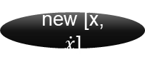
2.2 GP-based active learning
Dynamics
LQR
Gaussian Process Module
update
∇𝑉
init
Gaussian Process f
$\dot{x}$mean
x
$$\dot{V}$$
S
c
new [x, $\dot{x}$]
$\dot{x}$var
V_dot_mean = dV * mu
V_dot_var = dV^2 * fx_var
V_dot = mean + beta * np.sqrt(var)
# Calculate Safe set
S = get_safe_set(V_dot, threshold, S0)
# Find max c satisfying V(c) is subset of S with bisection
c = find_max_levelset(S, V, accuracy)
S[:] = V <= c
new_x = x_space[np.argmax(fx_var[S])]
new_x_dot = dynamic(new_x)

Slide 14
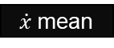


gym
Lyapunov Function Module
train
x_{i}
Policy
DDPG
a_{i}
gym
X_{i+1}
x_{i}
# Loss function
Loss = -a*V + b*V_dot
+ c*(||x||-V)^2 + d*V(x0)^2
Dynamics
NN
Dynamics
NN
$${\dot{x}}_{i+1}$$
$${\dot{x}}_{i+1}$$
train
∇𝑉
Loss
$$\dot{V}$$
Loss
$$\dot{V}$$
Lyapunov NN
Lyapunov NN
Counter examples x_{i}
V
V
train
train
Dynamics
NN
Gaussian Process Module
init
update
Gaussian Process f
$\dot{x}$mean
x
$$\dot{V}$$
S
c
new [x, $\dot{x}$]
$\dot{x}$var
V_dot_mean = dV * mu
V_dot_var = dV^2 * fx_var
V_dot = mean + beta * np.sqrt(var)
# Calculate Safe set
S = get_safe_set(V_dot, threshold, S0)
# Find max c satisfying V(c) is subset # of S with bisection
c = find_max_levelset(S, V, accuracy)
S[:] = V <= c
new_x = x_space[np.argmax(fx_var[S])]
new_x_dot = dynamic(new_x)

Slide 15
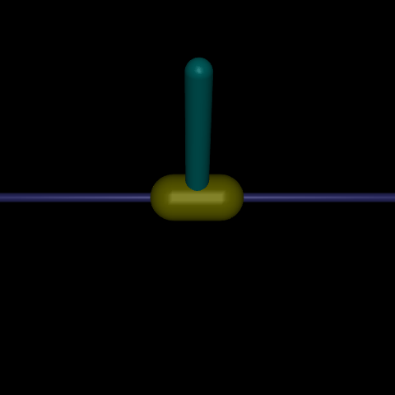
4. Experiment
Based on gymnasium inverted pendulum v1

Slide 16
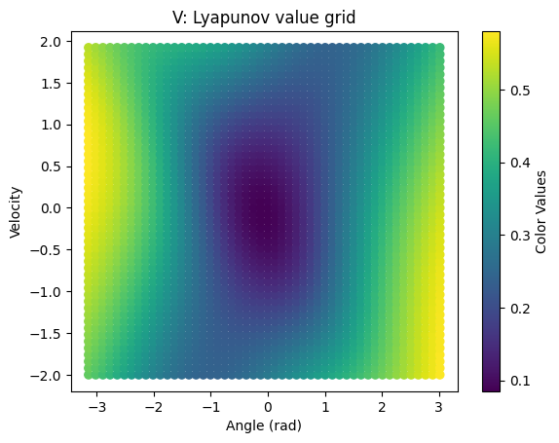
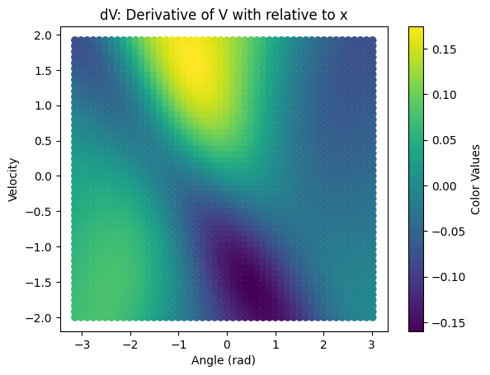
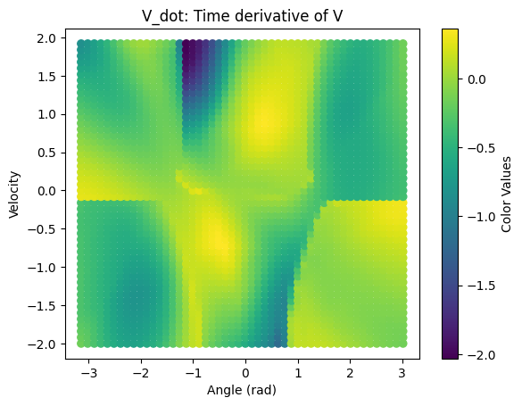
NN-based Lyapunov function
Figure 1a. V of state space
Figure 1b. dV of state space
Figure 1c. V_dot of state space
Notes:
Partial derivative of V with respect to x

Slide 17
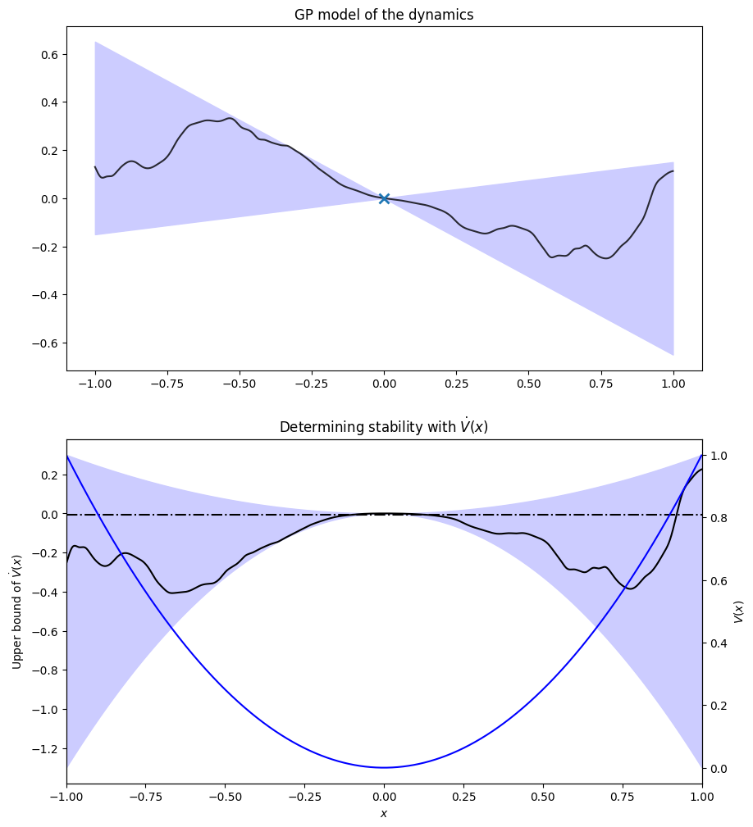
Active learning of GP model
Figure 2a. 1D GP variance, safe region with 1 point

Slide 18
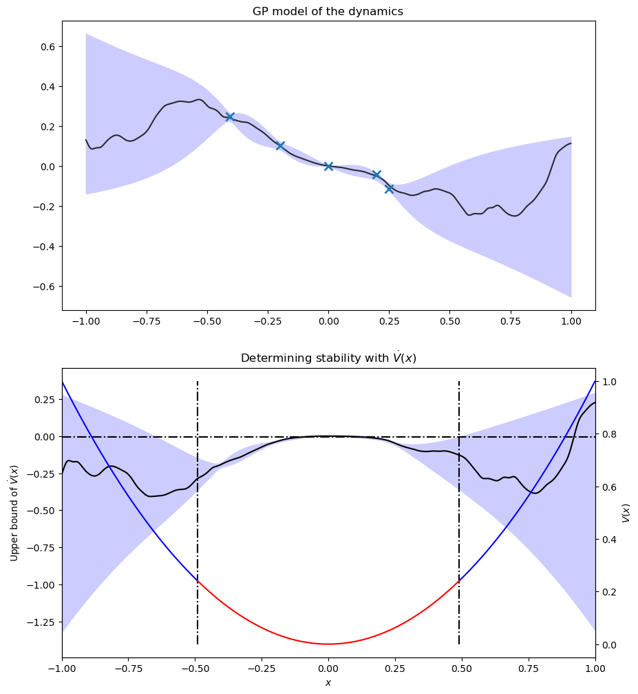
Active learning of GP model
Figure 2b. 1D GP variance, safe region with 5 points

Slide 19
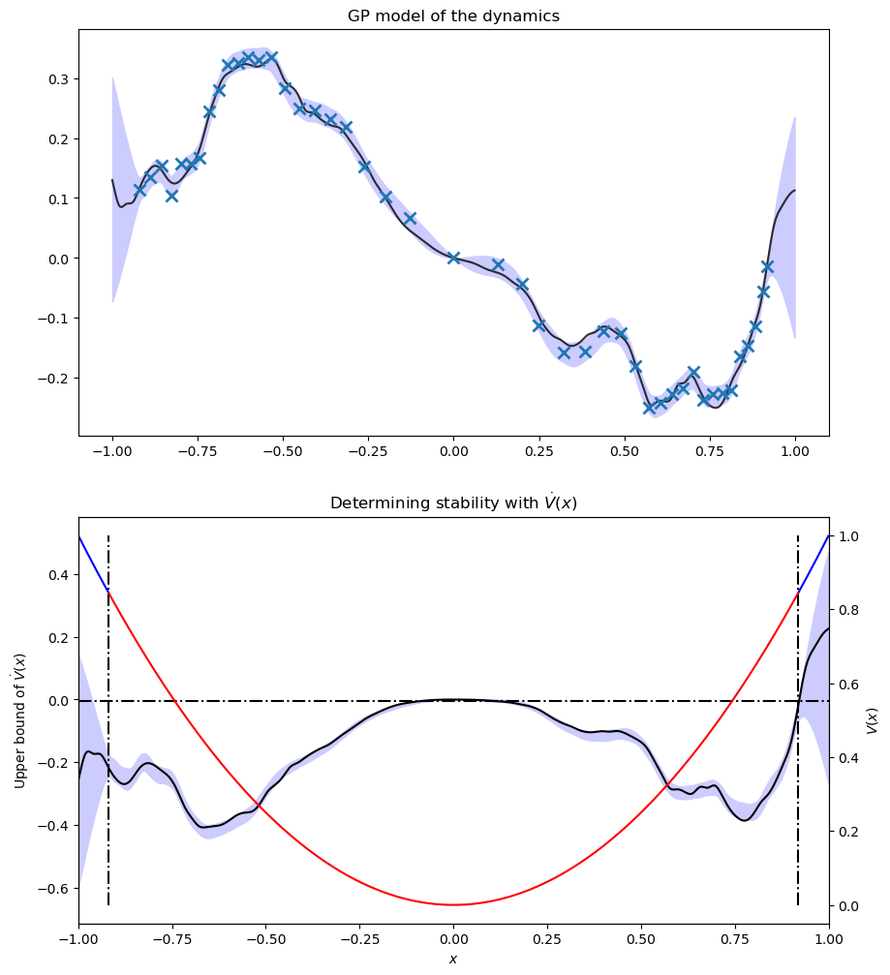
Active learning of GP model
Figure 2c. 1D GP variance, safe region with 50 points

Slide 20
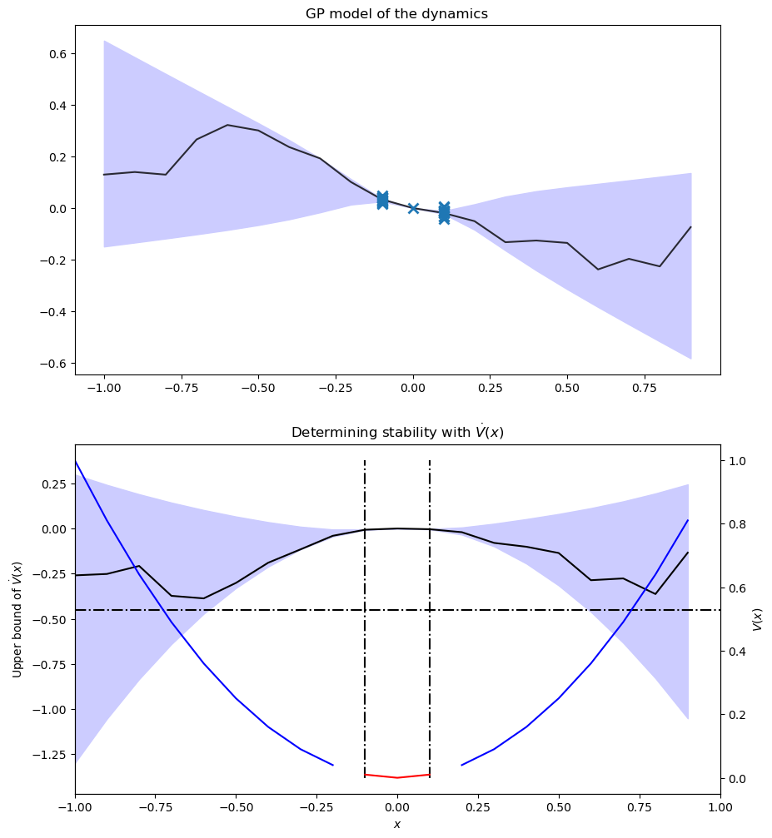
Active learning of GP model
Figure 2c. 1D GP variance, safe region with 50 points

Slide 21
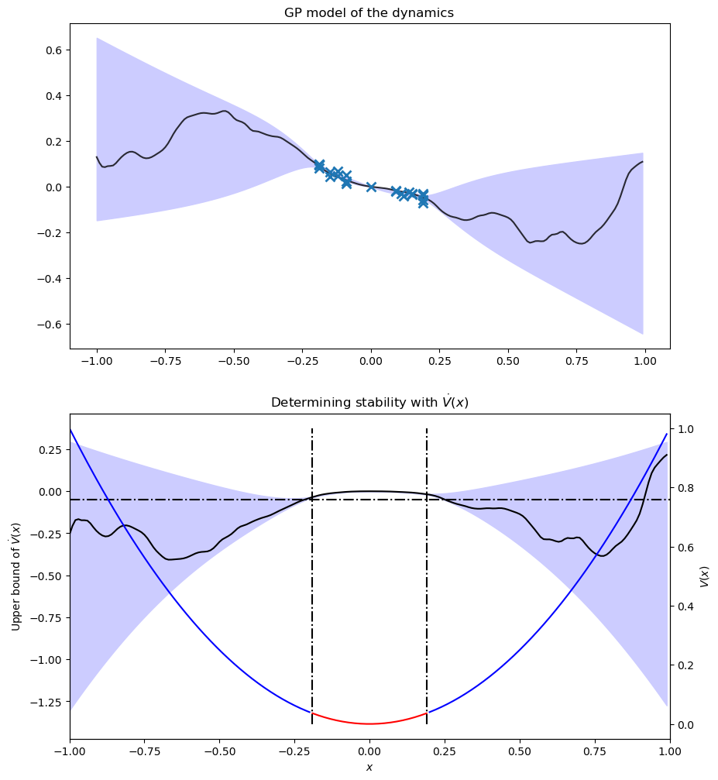
Active learning of GP model
Figure 2c. 1D GP variance, safe region with 50 points

Slide 22
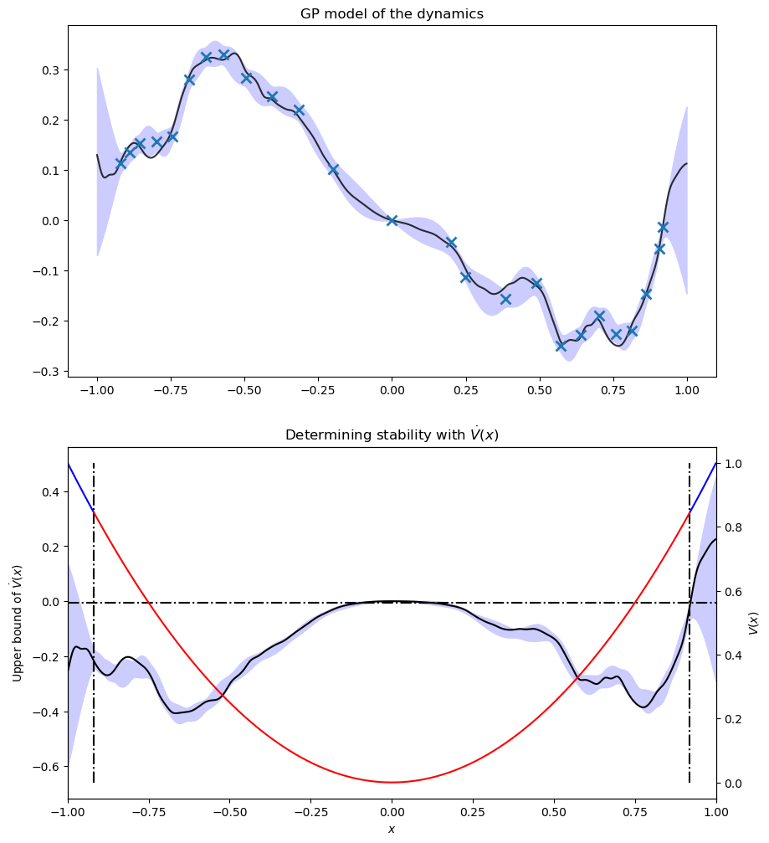
Active learning of GP model
tau = 0.01
max_id 10 max_state [[-0.09]] S_True: -L*tau: 40 S_True: V<=c 39 0.03999999998304524
Figure 2c. 1D GP variance, safe region with 50 points

Slide 23
GP model

Slide 24
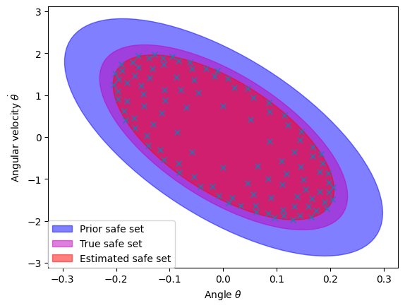
GP-based safe set
The true safe set constrain is set manually, considering the torque is limited so that the real system cannot recover from states with θ > 50 deg.
Prior safe set is based on the a priori dynamics model that initialized the GP model.
The estimated safe set shows the GP works for the bias between the true dynamic model and a priori model.

Slide 25
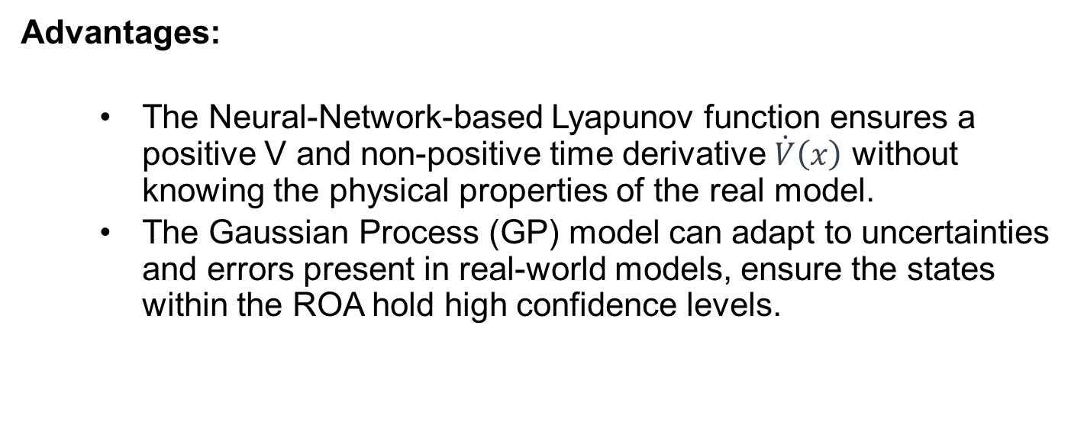
5. Conclusion
Advantages:
The Neural-Network-based Lyapunov function ensures a positive V and non-positive time derivative $\dot{V}\left(x\right)$ without knowing the physical properties of the real model.
The Gaussian Process (GP) model can adapt to uncertainties and errors present in real-world models, ensure the states within the ROA hold high confidence levels.

Slide 26
5. Conclusion
For Improvement
Discrete state space
Too many NN models, is it possible to design a end-to-end network?
Only one equilibrium point was applied in the project. Local asymptotically stable.

Slide 27
Thanks for your attention
Code is available on https://github.com/YBCheung/Safe_Learning

